Slide 1


Introduction to Python – Week 2
Mark Smith

Slide 2
Course outline
Lesson 1 – Getting Started: Introduction and Arithmetic Operators
Lesson 2 – Types and Variables
Lesson 3 – Functions
Lesson 4 – Conditional and Recursive Statements
Lesson 5 – Iteration
Lesson 6 – Strings
Lesson 7 – Lists
Lesson 8 – Dictionaries
Lesson 9 – Tuples
Lesson 10 – Project

Slide 3
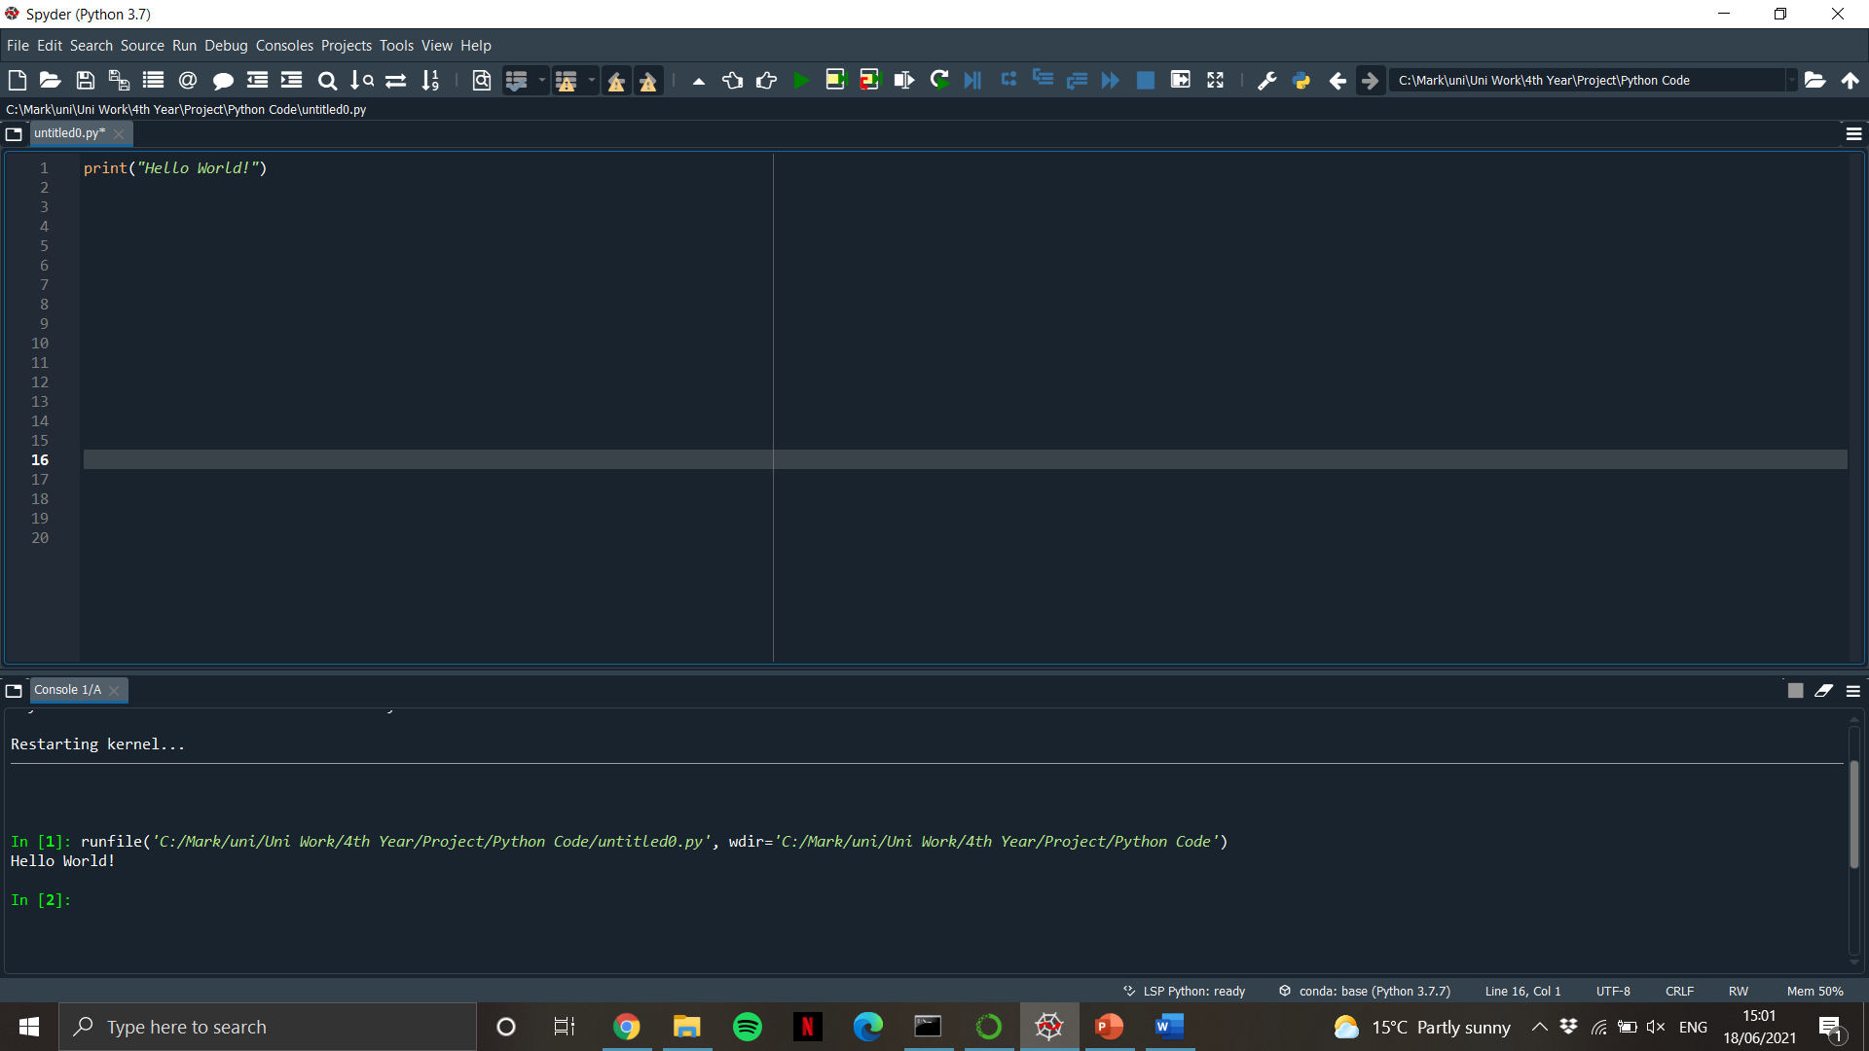
Last Week
What is a program?
What is Python?
Write our first program
Use Python as a Calculator
Python | Math
+ | +
- | -
/ | ÷
* | ×
** | ^

Slide 4
This Week – Types and Variables
Today we will learn:
What are Values and Types?
What is a variable?
How can we use variables?

Slide 5
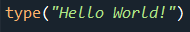
Values and types
Values are the most basic components of a program
Values belong to a type
We can find the type of a value by using the command:

Slide 6
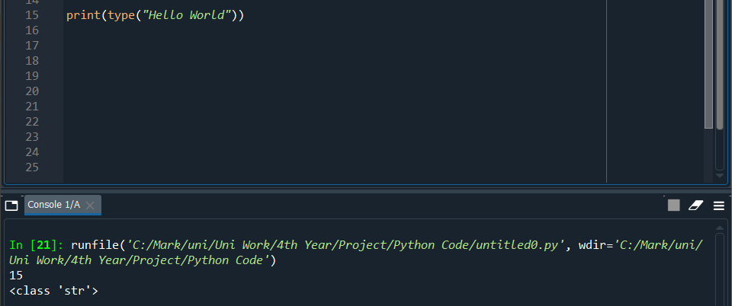
types
Code | Type
“Hello World!” or ‘Hello World!’ | str
20 | int
20.5 | float

Slide 7
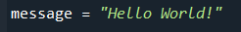
What is a variable?
A variable is a name that stores a value
It can be modified, initialised and deleted

Slide 8
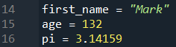
Assigning variables
An assignment statement allows us to initialise a variable:
Let’s practise creating some variables

Slide 9
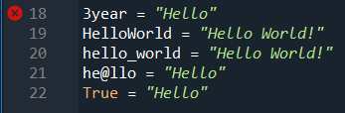
Naming variables
There are some rules when naming variables:
They cannot have spaces
They cannot begin with a number
Only use lower case letters
Use the underscore to separate words
Avoid illegal characters
Avoid keywords
Try to keep variable names short and descriptive

Slide 10
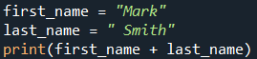
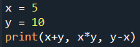
Variables with strings and numbers
Now, let’s use variables with Strings and Numbers to perform calculations and type messages
We can add two strings together using +
We can perform the operations we learned last week to variables

Slide 11
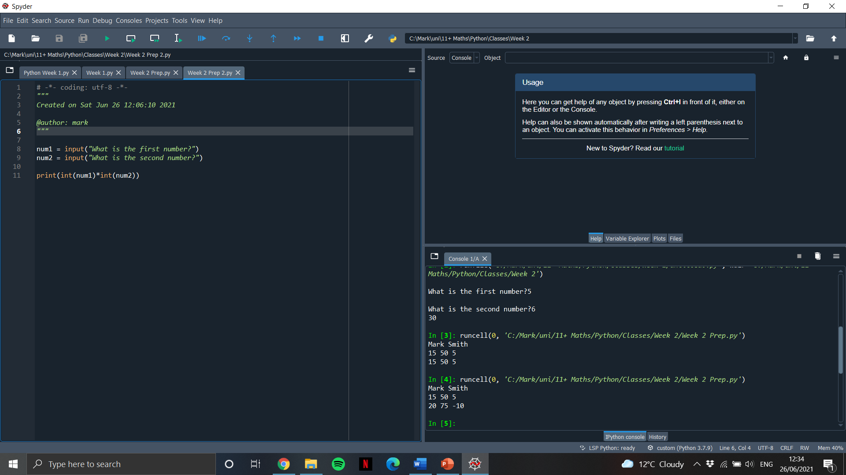
Input from user
We can take input from the user and store it in a variable as follows:

Slide 12
End of class
This week we have looked at:
Types and Values
What is a variable
Assigning variables with appropriate names
Modifying and using variables

